Slide 1
Introduction of Structured Learning
Hung-yi Lee

Slide 2
Structured Learning
We need a more powerful function f
Input and output are both objects with structures
Object: sequence, list, tree, bounding box …
X is the space of one kind of object
Y is the space of another kind of object
Notes:
Can DNN do that?

Slide 3
Example Application
Speech recognition
X: Speech signal (sequence) → Y: text (sequence)
Translation
X: Mandarin sentence (sequence) → Y: English sentence (sequence)
Syntactic Paring
X: sentence → Y: parsing tree (tree structure)
Object Detection
X: Image → Y: bounding box
Summarization
X: long document → Y: summary (short paragraph)
Retrieval
X: keyword → Y: search result (a list of webpage)
Notes:
Translation: http://citeseerx.ist.psu.edu/viewdoc/download?doi=10.1.1.377.8742&rep=rep1&type=pdf

Slide 4
Unified Framework
Energy-based Model: http://www.cs.nyu.edu/~yann/research/ebm/
Step 1: Training
Find a function F
Step 2: Inference (Testing)
Given an object x
F(x,y): evaluate how compatible the objects x and y is
Notes:
What is F? different people give it different name, Yan LaCu call it Enerygy model
This framework is every where

Slide 5
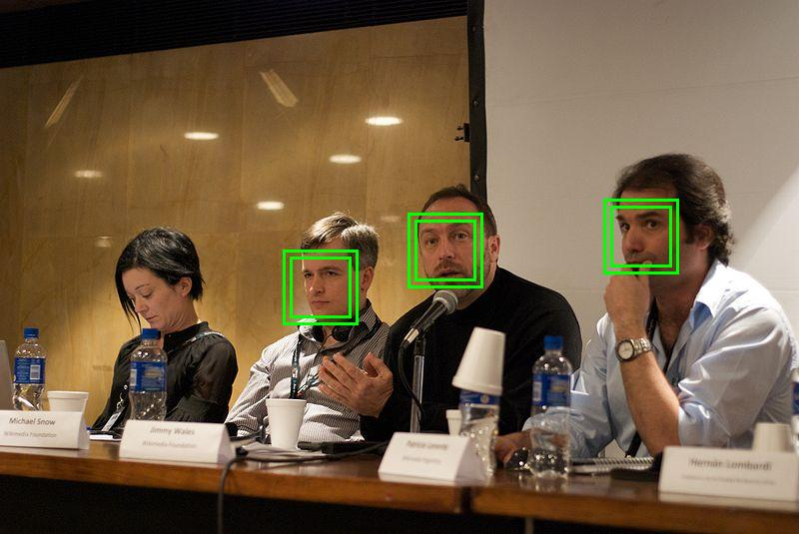
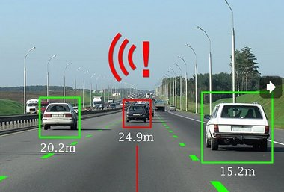

Unified Framework – Object Detection
Task description
Using a bounding box to highlight the position of a certain object in an image
E.g. A detector of Haruhi
Image
Bounding Box
Haruhi
(the girl with yellow ribbon)

Slide 6
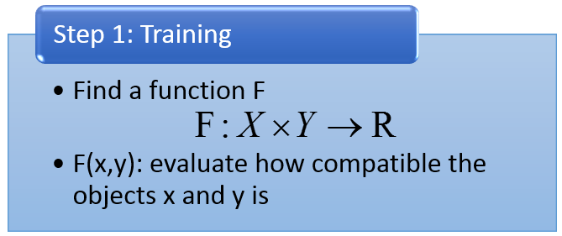



Unified Framework – Object Detection
F(x,y)
x: Image
y: Bounding Box
F(x,y)
F( )
the correctness of taking range of y in x as “Haruhi”

Slide 7

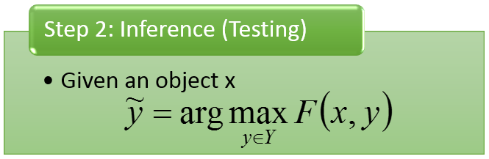


Unified Framework – Object Detection
(output result)
$$\tilde{y}$$
F(x,y)
10
3
2
……
input x =
Enumerate all possible bounding box y
-1

Slide 8



Unified Framework - Summarization
Task description
Given a long document
Select a set of sentences from the document, and cascade the sentences to form a short paragraph
long document
={s₁, s₂, s₃, ……s_{i}…}
summary
={s₁, s₃, s₅}
s_{i}: the i^{th} sentence

Slide 9





Unified Framework - Summarization
Step 1: Training
Step 2: Inference
F(x,y)
F(x,y)
x
y
x
y
d’
{s₁, s₃, s₅}
d₁
d₂
d’
{s₂, s₄, s₆}
d₁
d₂
d’
{s₃, s₆, s₉}

Slide 10
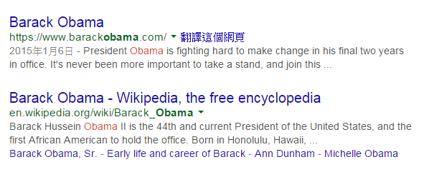
Unified Framework - Retrieval
Task description
User input a keyword Q
System returns a list of web pages
d10011
“Obama”
(keyword)
d98776
……
A list of web pages (Search Result)

Slide 11
Unified Framework - Retrieval
Step 1: Training
Step 2: Inference
F(x,y)
F(x,y)
d203
d330
……
d103
d300
……
x=“Haruhi”,
y=
d103
d300
……
x=“Obama”,
y=
x=“Bush”,
y=
d103
d304
……
x=“Haruhi”,
y=
d666
d444
……
x=“Obama”,
y=
d133
d220
……
x=“Bush”,
y=
d103
d305
……
x=“Haruhi”,
y=

Slide 12
Statistics
Step 1: Training
Estimate the probability P(x,y)
Step 2: Inference
Given an object x
Unified Framework
Step 1: Training
Find a function F
Step 2: Inference
Given an object x
F(x,y): evaluate how compatible the objects x and y is

Slide 13
Statistics
Step 1: Training
Estimate the probability P(x,y)
Step 2: Inference
Given an object x
Unified Framework
Drawback for probability
Probability cannot explain everything
0-1 constraint is not necessary
Strength for probability
Meaningful
Notes:
Statistics give unnecessary constraint.
Constraint: output 0 – 1 is difficult
Probability cannot explain everything
x=keyword, y=search results, what is the meaning of P(x,y)?
It is hard to estimate the probability
Can not observe the same object twice

Slide 14


Link to DNN?
The same as what we have learned.
Step 1: Training
Step 2: Inference
In handwriting digit classification, there are only 10 possible y.
y = [ 1 0 0 0 …… ]
N(x)
y = [ 0 1 0 0 …… ]
y = [ 0 0 1 0 …… ]
DNN
…
Find max
$$x$$
F(x,y)
$$x$$
Notes:
Can you answer the three problems for DNN?

Slide 15
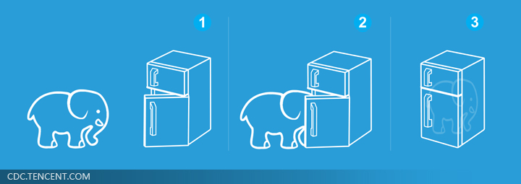
Unified Framework
Solve any tasks by two steps
Easier than putting an elephant into a refrigerator
Really?
No, we have to answer three problems.

Slide 16


Problem 1
Evaluation: What does F(x,y) look like?
How F(x,y) compute the “compatibility” of objects x and y
Object Detection:
F(x= , y= )
Summarization:
F(x= , y= )
(a long document)
(a short paragraph)
Retrieval:
F(x= “Obama” , y= )
(keyword)
(Search Result)

Slide 17
Problem 2
Inference: How to solve the “arg max” problem
The space Y can be extremely large!
Object Detection:
Y=All possible bounding box
(maybe tractable)
Summarization:
Y=All combination of sentence set in a document …
Retrieval:
Y=All possible webpage ranking ….

Slide 18
Problem 3
Training: Given training data, how to find F(x,y)
Principle
Training data:
We should find F(x,y) such that ……
……
……
for all
for all
for all

Slide 19


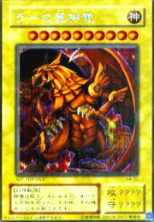
Three Problems
Problem 1: Evaluation
Problem 2: Inference
Problem 3: Training
What does F(x,y) look like?
Given training data, how to find F(x,y)
How to solve the “arg max” problem
Notes:
Have you ever heard this three questions before
No general task dependent
Ring a bell!!!!!!!!!!

Slide 20
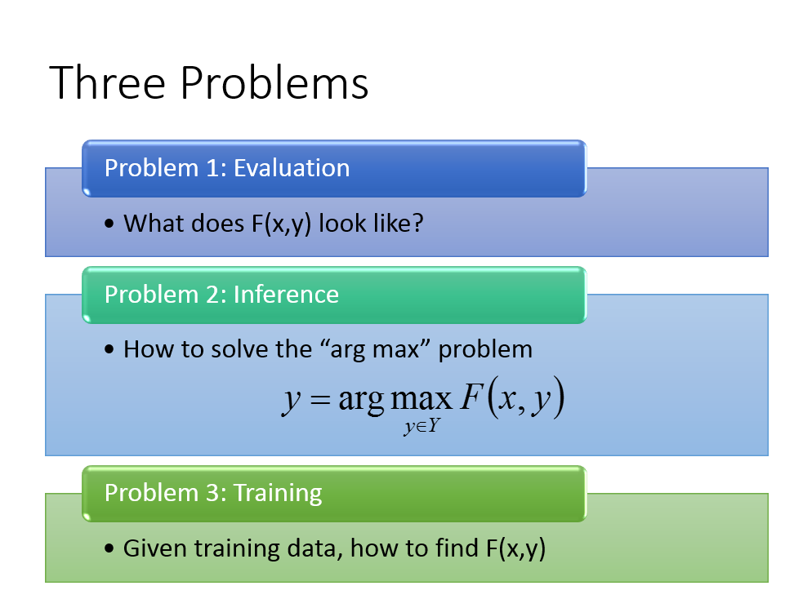
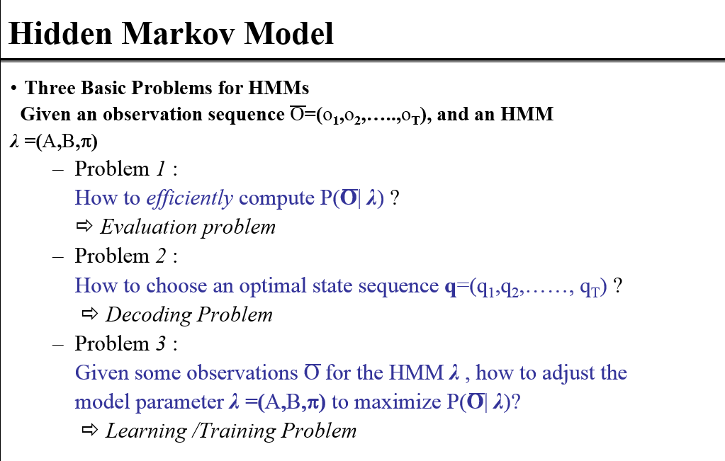
Have you heard the three problems elsewhere?
From 數位語音處理

Slide 21
Preview
Viterbi Algorithm
數位語音處理:
http://speech.ee.ntu.edu.tw/DSP2015Autumn/Videos/20150930_4.0.fsp.wmv/index.html (請用 IE 開啟)
http://speech.ee.ntu.edu.tw/DSP2015Autumn/Videos/20151007_4.0.fsp.wmv/index.html (請用 IE 開啟)
演算法
數位通信相關課程

